Slide 1

GEMINI-AI VOICEBOT
Presented By : Lakshmi Hasa(MST03-0055)

Slide 2


2
OVERVIEW
Introduction
Abstract
Key Features
Voicebot Functionality
Technical Architecture
User Interface
Future Enhancements
API Integration
Capabilities of Voicebot Conclusion

Slide 3
ABSTRACT
1
The Gemini-AI Voicebot is an advanced conversational assistant designed to provide seamless voice interaction, speech recognition technologies. It offers real-time, accurate responses to user queries by integrating with Google's Generative AI model. With features like speech-to-text conversion, text-to-speech synthesis, and personalized conversation history, the Gemini-AI Voicebot enhances user engagement and efficiency, making it an ideal solution for interactive and intuitive communication across various applications.

Slide 4

INTRODUCTION
3
The Gemini-AI Voicebot is a sophisticated voice- enabled chatbot built to deliver an intuitive and interactive user experience. By combining state-of- the-art AI technologies with natural language processing, it allows users to engage in fluid, real- time conversations, providing accurate responses and personalized interactions. Ideal for a variety of applications, the Gemini-AI Voicebot represents a significant advancement in voice-based communication tools.

Slide 5
VOICEBOT FUNCTIONALITY
4
A voicebot is an AI-driven software that interacts with users through voice commands, providing responses in real- time. It uses speech recognition and natural language processing to understand and respond to spoken queries.
Purpose
Highlight the primary objective providing real-time, accurate responses
Applications Personal assistants. Education Customer Support

Slide 6
5
KEY FEATURES
Speech Recognition: Converts spoken input to text using speech_recognition for accurate processing.
1
Google Generative AI Integration: Generates relevant responses using Google Generative AI for coherent conversations.
Real-time Response and Interaction: Processes and responds to user queries instantly for seamless communication.
2
3
Text-to-Speech Synthesis: Uses gTTS to turn text responses into speech, enhancing interaction.
4

Slide 7
6
TECHNICAL ARCHITECTURE
Environment Setup (dotenv, API Keys):
The dotenv library is used to securely manage environment variables, such as the API key for Google Generative AI, ensuring sensitive information is protected and easily configurable.
Core Components:
The system uses Streamlit for the web interface, Google Generative AI for generating responses, and gTTS for converting text responses into speech, forming the backbone of the voicebot's functionality.

Slide 8
API INTEGRATION
7
Google Generative AI API Configuration :
Setu. p & Integration: The Google API is configured to generate responses, crucial for the bot's functionality. This integration enables the bot to deliver accurate and relevant answers.
Interaction with Gemini-Pro Model:
Processing Queries: The bot uses the Gemini-Pro model to interpret and respond to user queries, ensuring contextually appropriate answers.

Slide 9
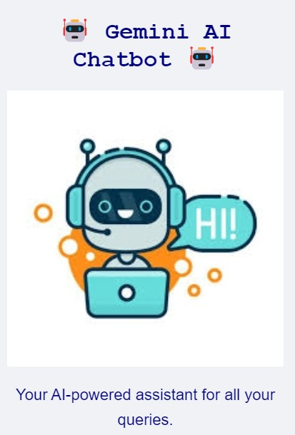
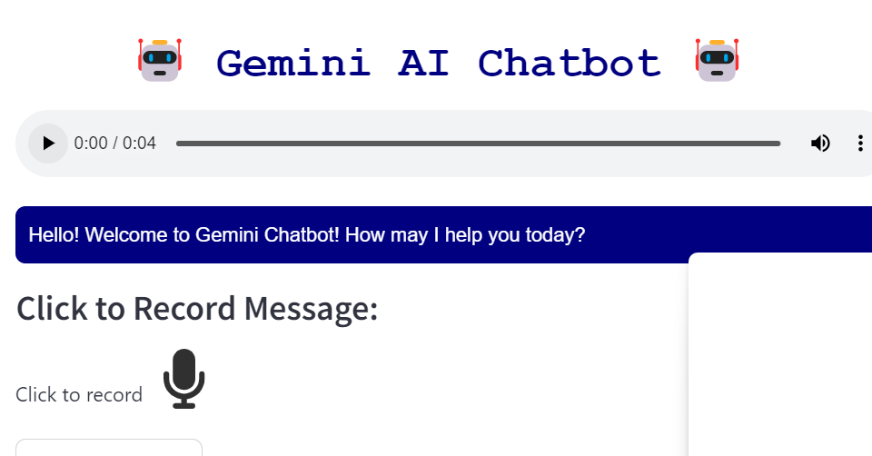
USER INTERFACE
8

Slide 10
USER INTERFACE
9
CSS
Custom CSS is used to enhance
the visual appeal and usability of the interface. It defines the look of the chat layout and sidebar, including colors, fonts, and spacing, creating a cohesive and user-friendly design that improves overall user experience.
Sidebar Features and Main Chat Area:
The sidebar presents key elements like the bot's title, an image, and a brief description, helping users quickly understand the bot's purpose. The main chat area is dedicated to the conversation, displaying user inputs and bot responses in a clean, organized manner.

Slide 11

CAPABILITIES OF VOICEBOT
11
The Gemini AI Voicebot combines advanced speech recognition, seamless text-to-speech synthesis, and Google Generative AI to deliver real-time, contextually relevant interactions. Its intuitive interface and robust error-handling mechanisms
make it a engagement
versatile tool for enhancing across various applications,
user from
customer support to personal assistance.

Slide 12

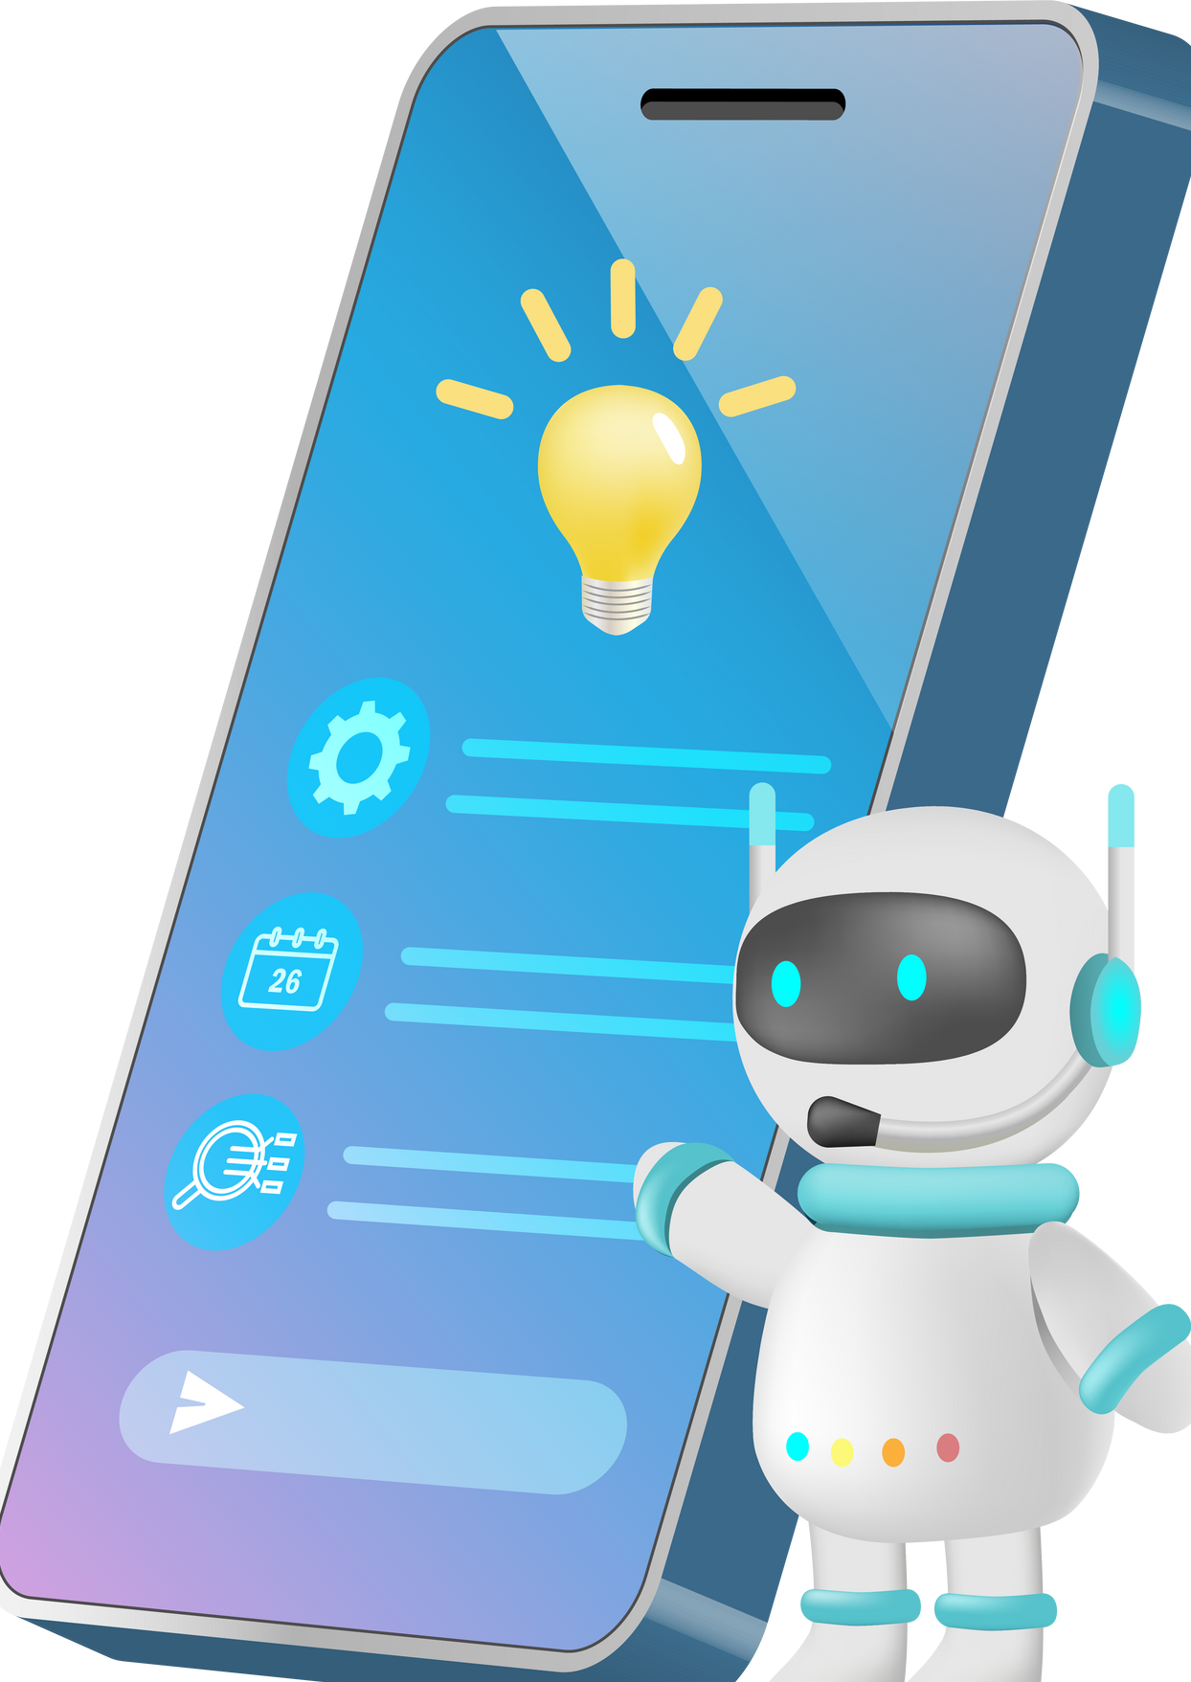
FUTURE ENHANCEMENTS
12
To further elevate the Gemini AI Voicebot, potential
adding multi-language support to reach a broader audience and
improvements include
integrating advanced sentiment analysis to better understand and respond to user emotions. These enhancements would significantly expand the bot's functionality and make it more adaptable to diverse user needs.

Slide 13
CONCLUSION
13
In summary, the seamless integration of Google Generative AI and the Gemini-Pro model empowers the voicebot with advanced, context-aware capabilities. By leveraging `st.session_state` for efficient conversation management and employing sophisticated speech-to-text and text-to- speech technologies, the voicebot delivers a fluid and engaging user experience. This sophisticated setup ensures that interactions are not only smooth but also highly responsive, setting a high standard for conversational AI.

Slide 14
THANK YOU
Presented By : Lakshmi Hasa(MST03-0055)

